Slide 1
PROJECT PRESENTATION
GARBAGE MANAGEMENT SYSTEM
NAME: SHARON SAJI
REGISTER NO: 22PMC151

Slide 2
ABSTRACT
The Garbage Management System is a web-based application built using the Django framework that aims to streamline and enhance the management of garbage in a given locality or community. The system provides a user-friendly interface for customers to schedule pick ups for their household waste at a very affordable rate. The system incorporates various features and functionalities to achieve these objectives. Users can register and log in to the system to select a package for collection, schedule pick-ups and see the status of their pick-ups. The system admin will be able to add packages, employees and also schedule employees to different pick-up locations.

Slide 3
REQUIREMENTS
Login and registration
Packages
User details
Date scheduling
Assigning employee for pick-up
Changing the delivery status
History

Slide 4
FEATURES AND HIGHLIGHTS
Login and registration: The user will be able to register themselves using Django users. The user will be redirected to the user home page after logging in. The admin adds the employee using the Django admin interface. Both admin and employee will be redirected to their respective pages after logging in from the interface.
Add user details: The user will be able to add his/her details after logging in and can also update their details whenever they would like to using the interface.
Adding the packages: The admin will be able to add the packages using the django admin interface with an option to delete and update them as required.

Slide 5
Selection of packages: The user will be able to select from the given packages once he/she has logged in.
Scheduling the pick-up: The user will be able to schedule pick-up using a modal form. Each package will have a specified no of pick-ups. The user will only be able to make those many no of schedules for a particular month according to the package chosen.
Employee Details: The employees will be added directly by the admin and the is_staff permission will be enabled for the employees while adding them. The employee can login in using his/her mail id and password provided by the admin.

Slide 6
Assigning the employees: The admin will be able to assign a particular employee to a scheduled task using the Django admin interface.
Changing the status of a task: The employee will be able to see the task assigned by the admin on his interface and will be able to change the status (scheduled, enroute, order picked) of a particular task.
Status updation on the user page: The user will be able to see the status of each schedule on their interface as and when the employee changes it.
History: The user will be able to see all the previous pick-up history on his/her page to keep track of the no of pick-ups scheduled by them.

Slide 7
THIRD-PARTY LIBRARIES
Third-party applications and libraries in Django are pre-built components or packages developed by the community or other companies that you can use to extend the functionality of your Django projects.
The third party libraries used in my project is:
Django Crispy Forms: A library that helps you create beautiful, responsive forms using Bootstrap, Foundation, or other CSS frameworks. It simplifies form rendering and styling while maintaining a clean separation between the HTML and Python code. I have also installed a Bootstrap5 template pack for django-crispy-forms.
Django Jazzmin: a drop-in app to jazz up your Django admin site, with plenty of things you can easily customize, including a built-in UI customizer.

Slide 8
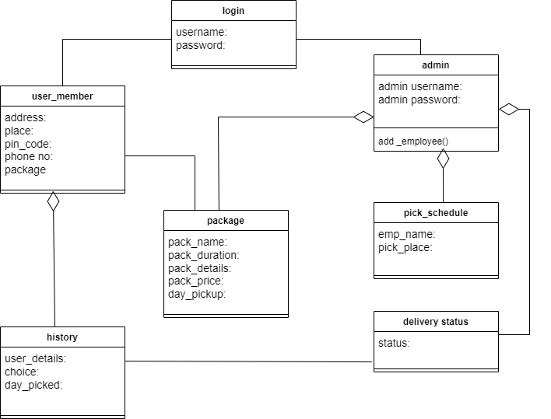
CLASS DIAGRAM

Slide 9
CHALLENGES FACED
The major challenge faced by me was to plan the process flow of the project. While coming to the coding part I had difficulties in using the Django user for registering customers as it was new to me. The next major challenge which I faced was during the integration of crispy-forms in my project. Even though it made my work easy by helping me from the hectic task of creating html pages , I did require some time to learn about the working of it.

Slide 10
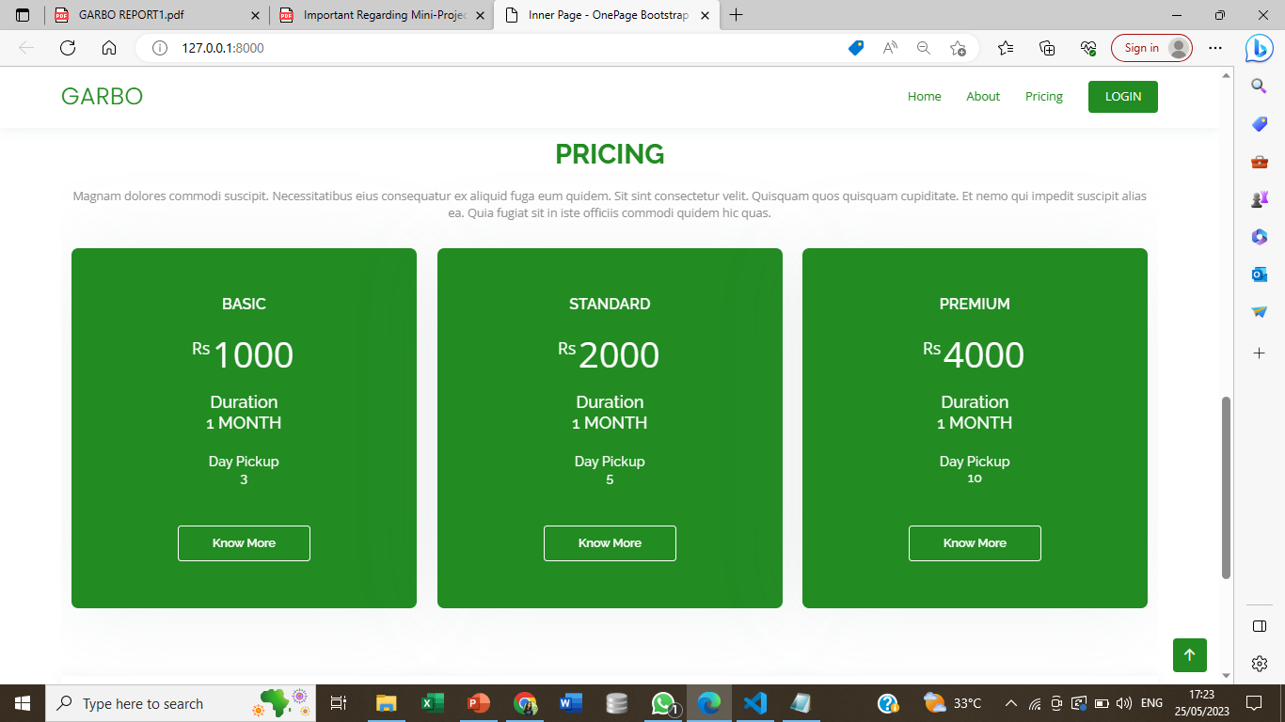
SCREENSHOTS
The home page is made dynamic by displaying the details of the packages from the Django admin site for the users.

Slide 11
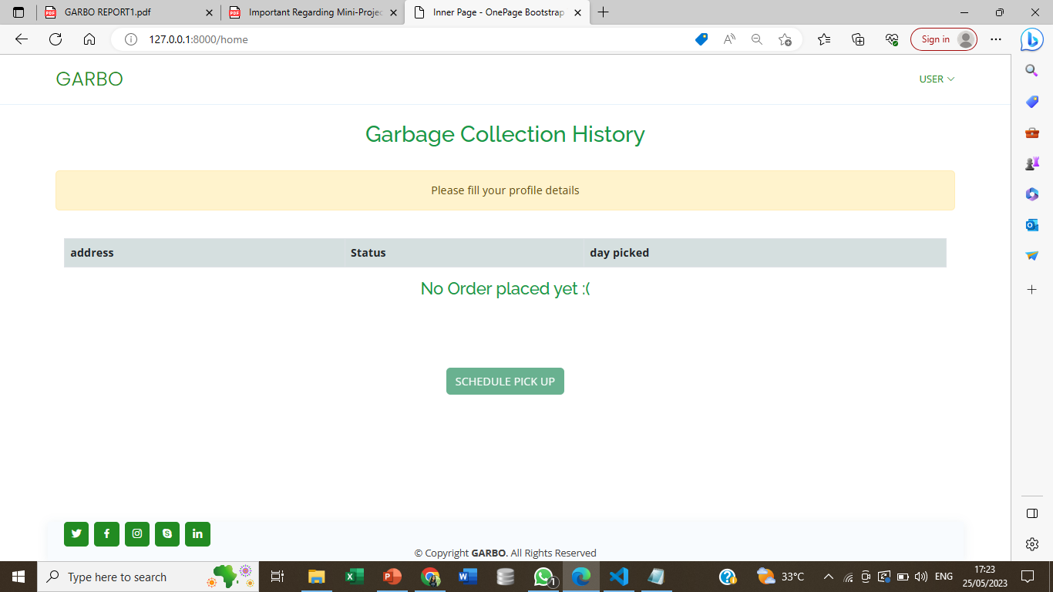
This is the homepage of a newly logged in users. The user will only be able to schedule for pick-ups once he/she will give their basic details and choose a package for the garbage collection.

Slide 12
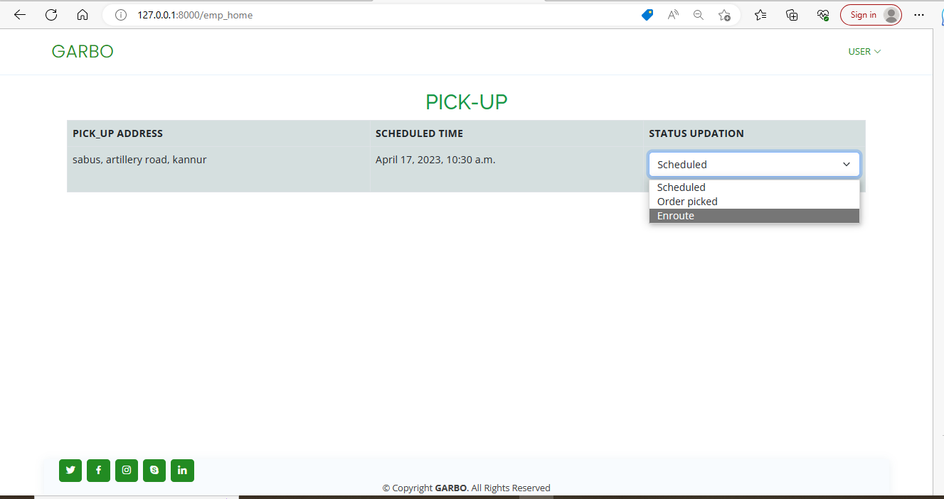
This is the employee page where the employee will be able to see his/her assigned pick-ups and also will be able to change the status of the pick-ups.

Slide 13
FUTURE ENHACEMENTS
Payment page: A payment portal can be added in the future for paying for the packages.
Live tracking: The user should be able to track the collector as and when he changes the status to enroute.
Mobile application: Introduction of a mobile application can also be done so that this system becomes more user friendly

Slide 14
CONCLUSION
Garbo is a web-based application which helps customers to efficiently dispose their household wastes. This website consist of a user friendly interface from where he/she will be able to choose from different package options given by the website. The website provides the user with an option to schedule pick-ups as per their convenience. Not only that the user will also be able to see the status of their scheduled pick-ups. Apart from the users the admin and employee also plays a vital role in this website.

Slide 15
REFERENCES
https://dev.to/thearjun/integrate-django-jazzmin-theme-to-django-admin-adminlte-dashboard-5aao
https://docs.djangoproject.com/en/4.2/
https://getbootstrap.com/docs/5.0/getting-started/introduction/
https://pypi.org/project/django-crispy-forms/

